Slide 1



A UNIVERSITY CAMPUS SUFFOLK GAME

Slide 2
Roles Since Previous Milestone
Dean Leaks
  Project Management
  Shark Animation
  Additional Assets / UI
Roger Creyke
  Building the game engine
  Controls
  Game Refinement
Ryan Avent
  Character Animation
  Character Rendering
  Primary Game Assets
George Daters
  Menu System
  Snow Effect
  Shark AI

Slide 3

Progressometer
October
Vertical Slice
May

Slide 4
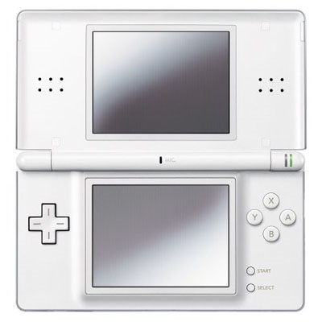
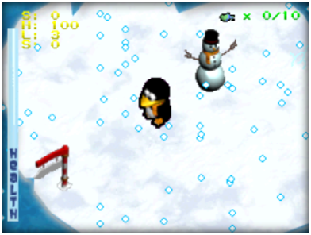


Slide 5

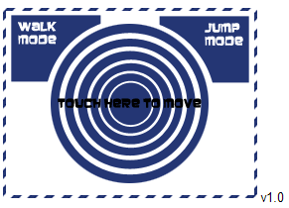
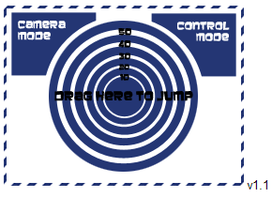
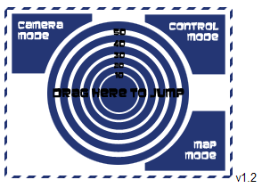
Design: UI
This shows the evolution of the user interface.
Dragging the stylus across the middle makes the character jump
The longer the drag the larger the jump
Touching the corner sections activates the different modes

Slide 6
















Design: Arctic Shark
In order to make the characters we animated in 3dsMax so multiple frames could be rendered out and then these could be used as sprites in the game engine

Slide 7
What next?
Completion of the 1st tutorial level
Testing of that tutorial level to make sure people can easily learn controls & play the game.
Create more levels.
Finish level/character select screens
Finish Level ending screens

Slide 8


